Slide 1
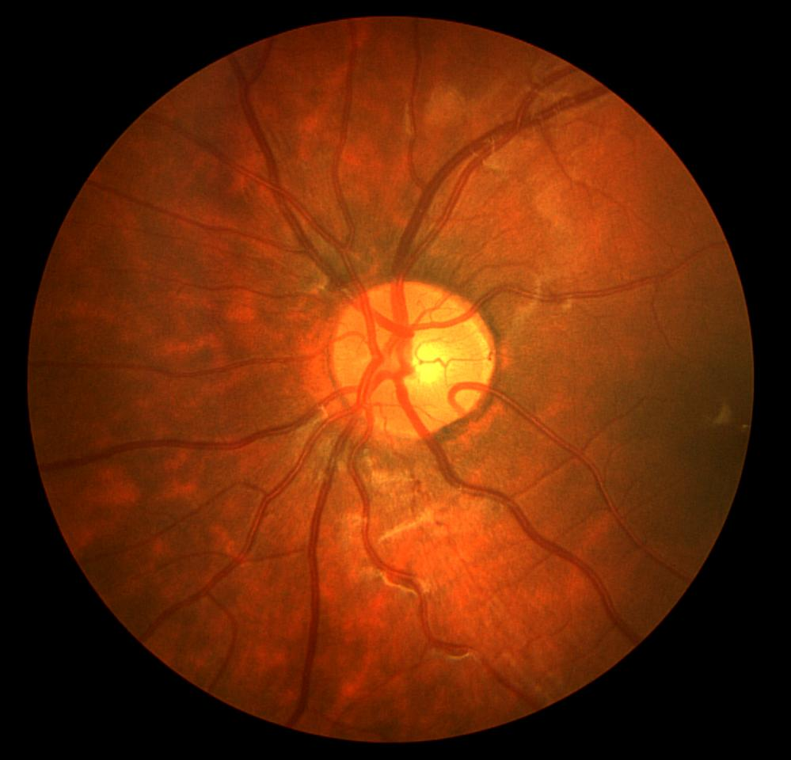
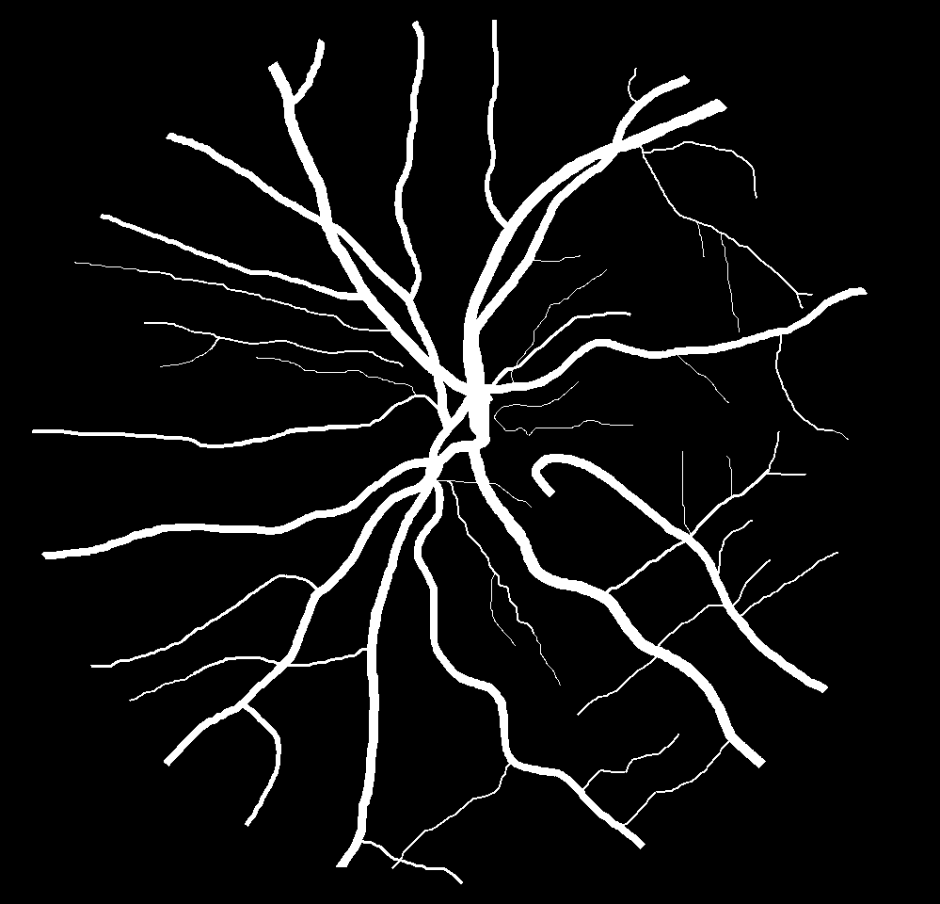
Segmentation of blood vessels in retinal fundus images

Slide 2
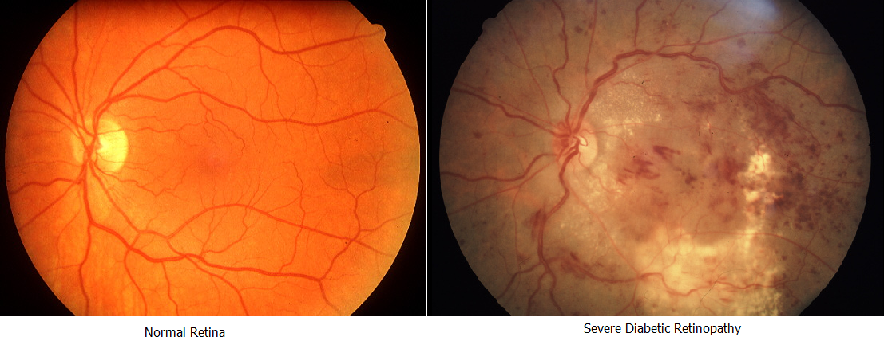

Slide 3
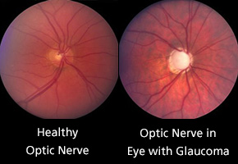

Slide 4
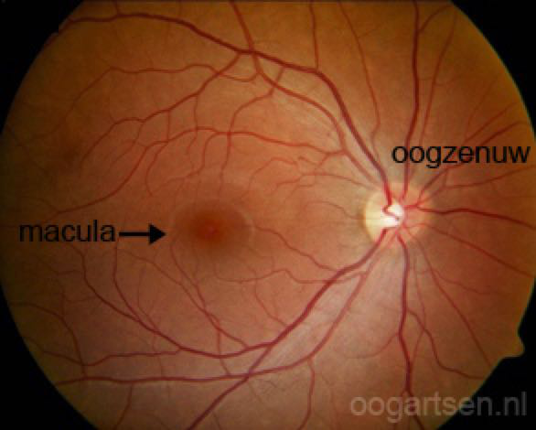
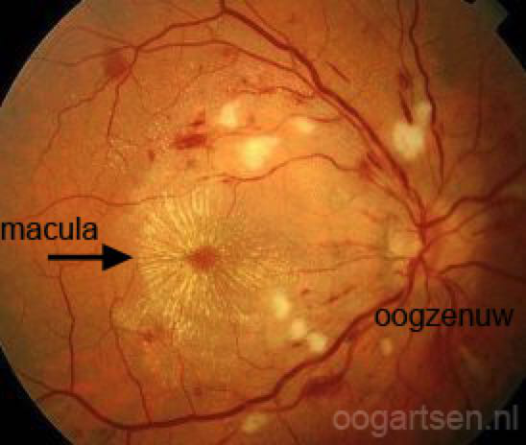
Healthy
Hypertension damage

Slide 5
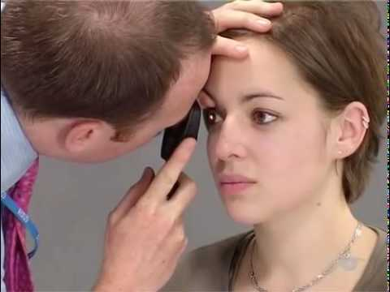
Ophtalmoscopy

Slide 6
Retinal image
Segmentation
Automatic segmentation

Slide 7
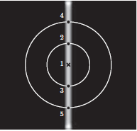
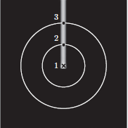



Simple bar-selective filter: B-COSFIRE
Automatic configuration
$$ρ$$
φ
Each point described by:
Rotation invariance:

Slide 8

Filter application
Use a Gaussian for tolerance, std. Dev.:
Response for one point:
Multiply the shifted responses -> COSFIRE

Slide 9
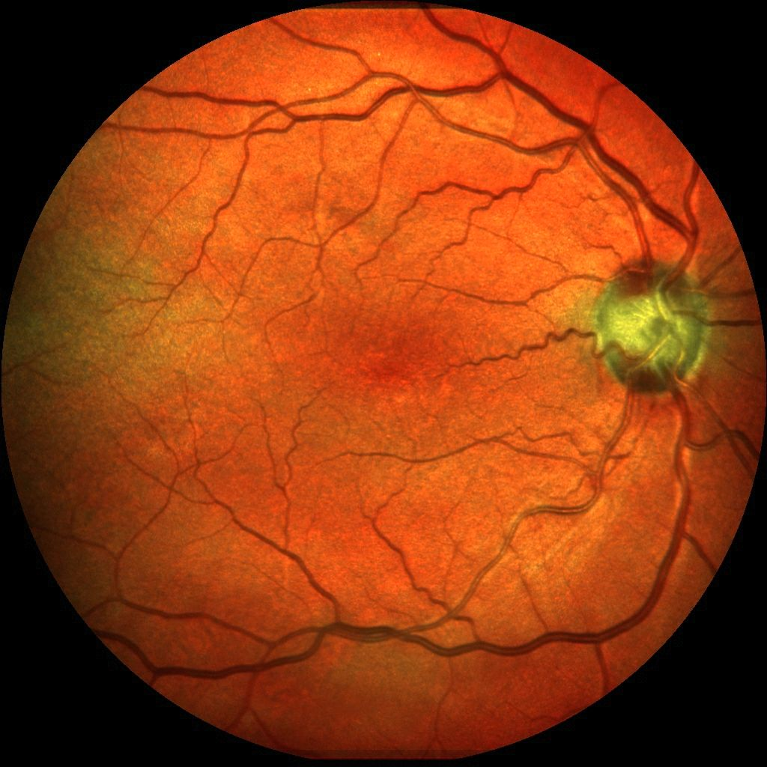
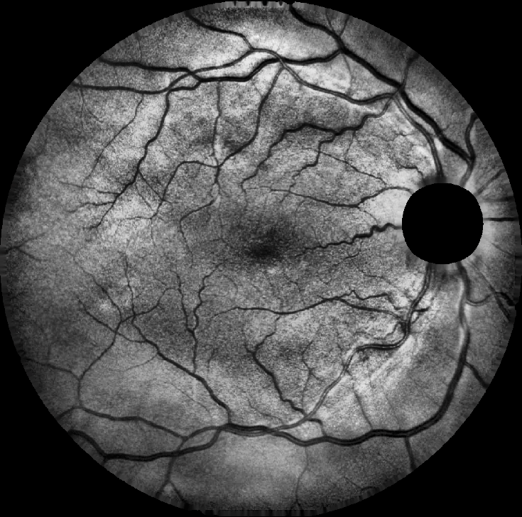
Pre-processing
Original image
Mask
Green channel

Slide 10
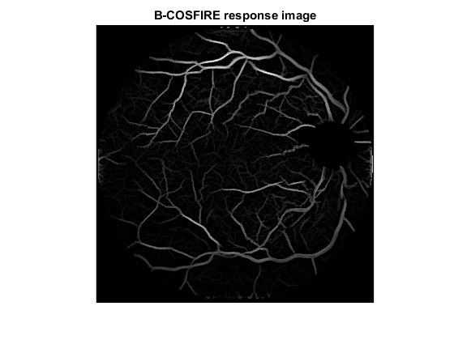
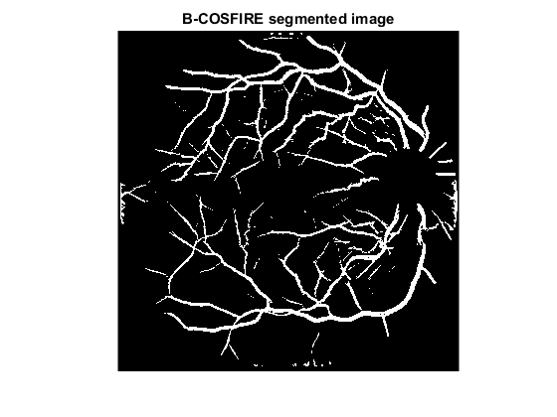
Putting it all together
B-COSFIRE
Threshold

Slide 11


Tuning parameters B-COSFIRE
σ:
ρ: The largest circle
σ₀
α
$$ρ$$
Symmetric: σ = 4.8, ρ = 20, σ₀ = 3, α = 0.3
Assymetric: σ = 4.4, ρ = 36, σ₀ = 1, α = 0.1

Slide 12

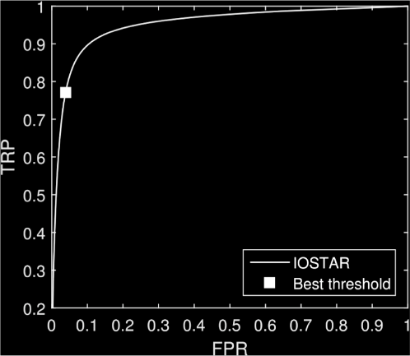

Segmentation performance
t = [0,1]
$∀$t $→$ TPR,FPR

Slide 13
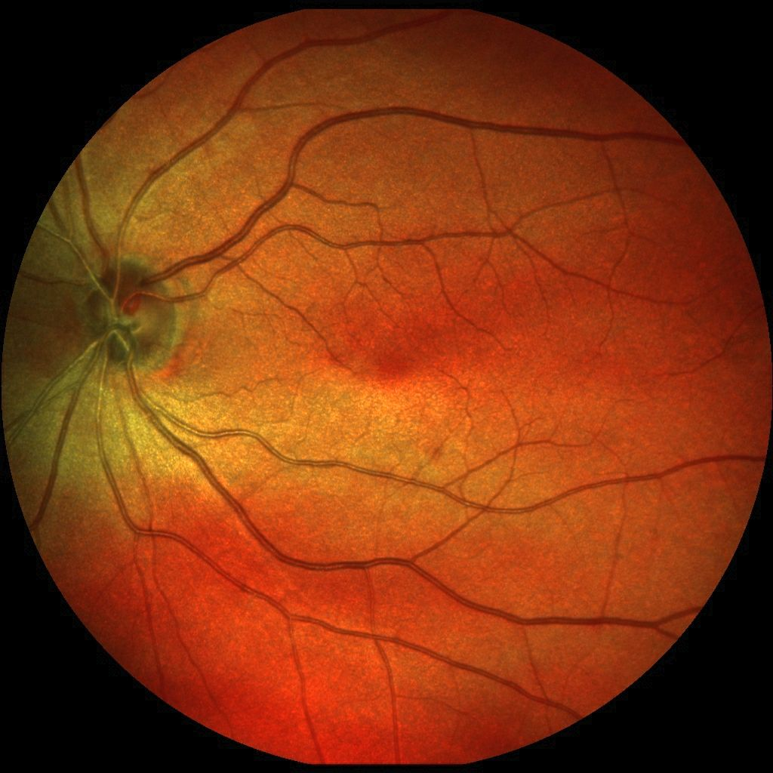

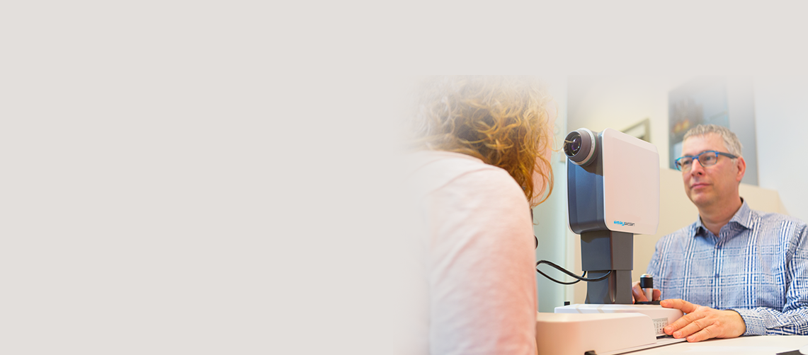
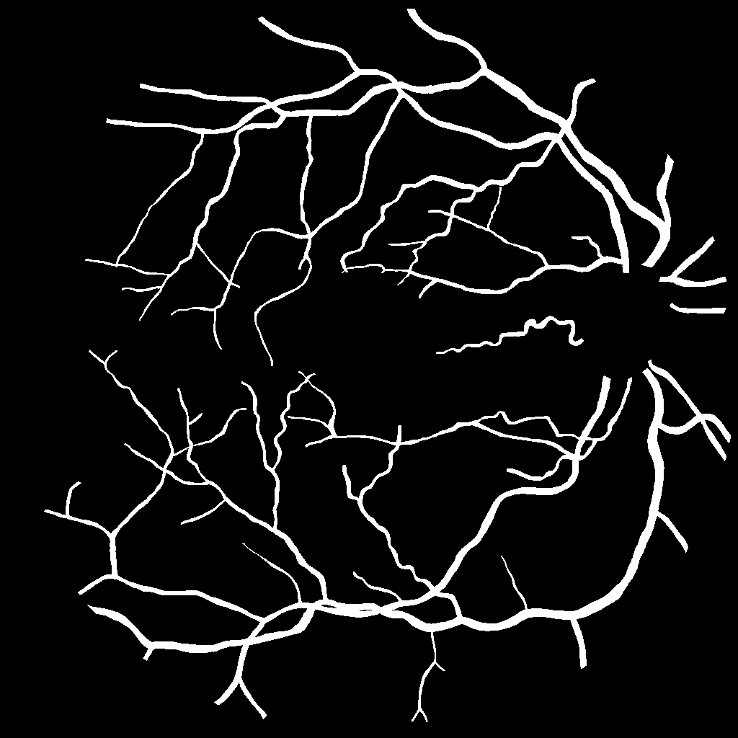
IOSTAR
EasyScan Optics B.V. The Netherlands

Slide 14

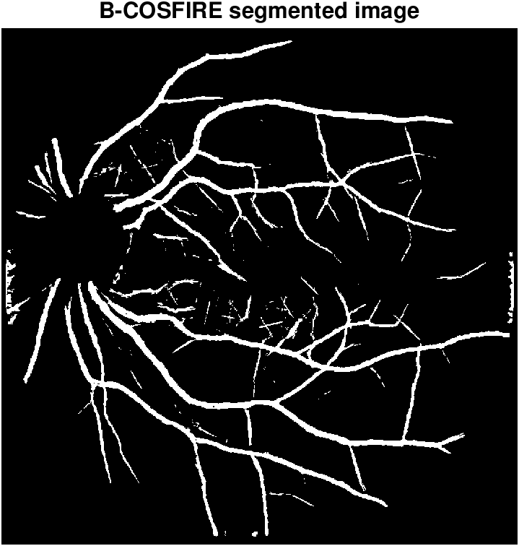
Results

Slide 15
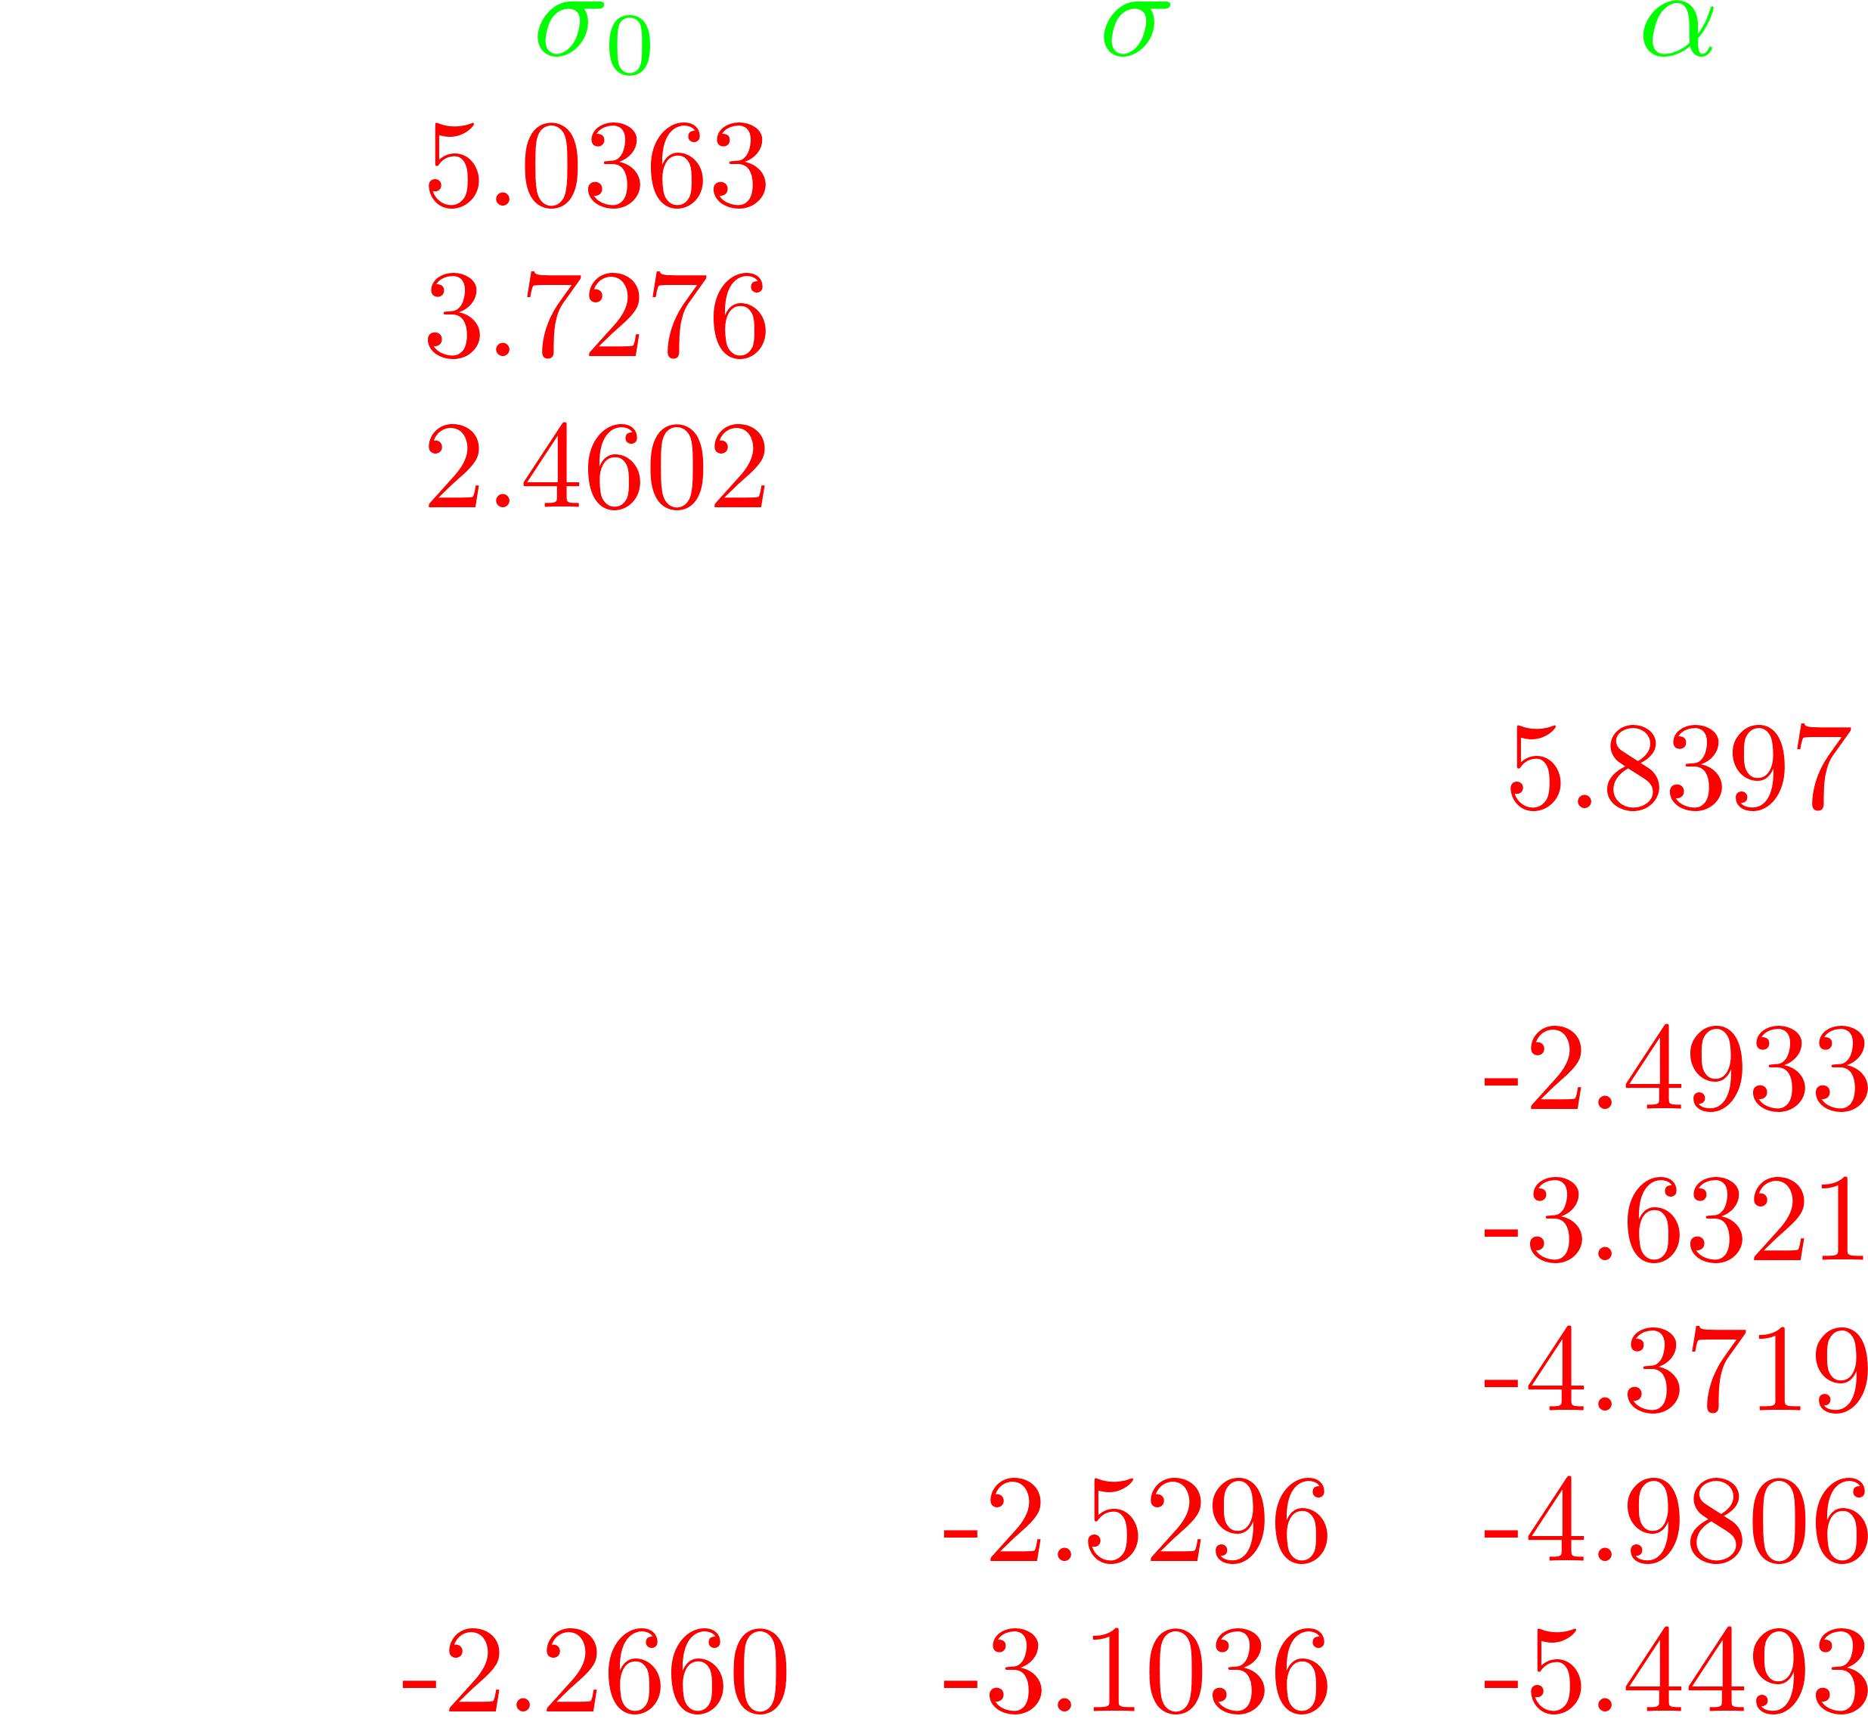


Sensitivity of parameters
Symmetric: σ₀ = 3 σ = 4.8 α = 0.3
Paired T-test
Red: Significantly different segmentation
White: Similar segmentation
Small deviation $α$
Large performance difference

Slide 16
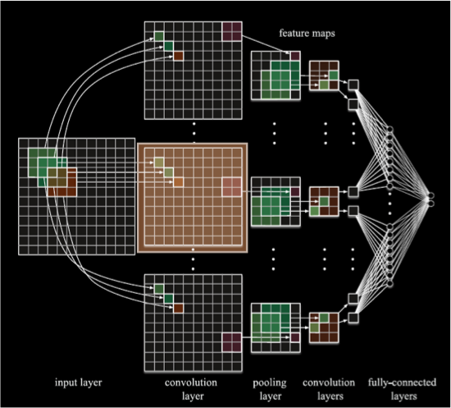


Machine learning approaches
Training pase
Working phase

Slide 17
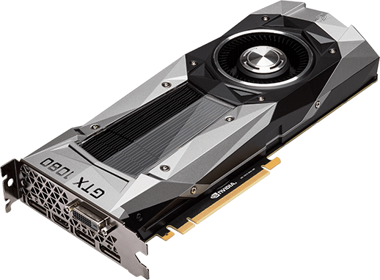

Deep neural network
B-COSFIRE
Training/estimating
>
8 hours
Single GPU
± 10 minutes
Human
Segmenting
>
92 seconds
High-end GPU
10 seconds
2 GHz CPU
AUC: .9720
>
AUC: .9614

Slide 18
Thank you.

